Slide 1


INFORMATION SECURITY
LECTURE 02
Dr. Muhammad Umar Aftab

Slide 2

LECTURE CONTENTS
Attacks Using Malware
Malware classification
Social Engineering Attacks

Slide 3
Introduction
  A network attack can be defined as any method, process, or means used to maliciously attempt to compromise network security.
  In general, two types of attacks threaten the confidentiality of information:
    Snooping
    Traffic Analysis

Slide 4
Snooping
  Snooping refers to unauthorized access or interception of data. For example, a file transferred through the Internet may contain confidential information. An unauthorized entity may intercept the transmission and use the contents for their own benefit.

Slide 5
  Traffic Analysis
  Although encipherment of data may make it no intelligible for the interceptor, she/he can obtain some other type information by monitoring online traffic. For example, she can find the electronic address (such as the e-mail address) of the sender or the receiver. She can collect pairs of requests and responses to help her guess the nature of transaction.

Slide 6
  Attacks Threatening Integrity
  The integrity of data can be threatened by several kinds of attacks:
  Modification
  Masquerading
  Replaying
  Repudiation.

Slide 7
  Modification
  After intercepting or accessing information, the attacker modifies the information to make it beneficial to herself. For example, a customer sends a message to a bank to do some transaction. The attacker intercepts the message and changes the type of transaction to benefit herself. Note that sometimes the attacker simply deletes or delays the message to harm the system or to benefit from it.

Slide 8
Masquerading
  Masquerading, or spoofing, happens when the attacker impersonates somebody else.
  For example, an attacker might steal the bank card and PIN of a bank customer and pretend that she is that customer. Sometimes the attacker pretends instead to be the receiver entity. For example, a user tries to contact a bank, but another site pretends that it is the bank and obtains some information from the user.

Slide 9
  Replaying
  Replaying is another attack. The attacker obtains a copy of a message sent by a user and later tries to replay it.
  For example, a person sends a request to her bank to ask for payment to the attacker, who has done a job for her. The attacker intercepts the message and sends it again to receive another payment from the bank.

Slide 10
  Repudiation
  This type of attack is different from others because it is performed by one of the two parties in the communication: the sender or the receiver. The sender of the message might later deny that she has sent the message; the receiver of the message might later deny that he has received the message.
  An example of denial by the sender would be a bank customer asking her bank to send some money to a third party but later denying that she has made such a request. An of denial by the receiver could occur when a person buys a product from a manufacturer and pays for it electronically, but the manufacturer later denies having received the payment and asks to be paid.

Slide 11
Passive Versus Active Attacks
Let us now categorize the attacks into two groups
  Passive
  Active.
Attacks
Passive Attacks
Active Attacks
Interception
Denial of service
Fabrication
Reading Message Content
Traffic Analysis
Message Replay
Message Modification

Slide 12
Malware attack
A malware attack is a common cyberattack where malware (normally malicious software) executes unauthorized actions on the victim’s system. The malicious software (a.k.a. virus) encompasses many specific types of attacks such as
  Ransomware
  Spyware
  Command and control
  and more.

Slide 13
Malware attack
Criminal organizations, state actors, and even well-known businesses have been accused of (and, in some cases, caught) deploying malware. Like other types of cyber attacks, some malware attacks end up with mainstream news coverage due to their severe impact.
An example of a famous malware attack is the WannaCry ransomware attack.
Notes:
In May 2017 by the WannaCry ransomware cryptoworm, which targeted computers running the Microsoft Windows operating system by encrypting data and demanding ransom payments in the Bitcoin cryptocurrency

Slide 14
Malware Types
There are many different types of malware e.g..
Worms
Viruses
Bots & Botnets
Trojan Horses
Ransomware
Adware & Scams
Spyware
Spam & Phishing

Slide 15
Worms
Worms are spread via software vulnerabilities or phishing attacks. Once a worm has installed itself into your computer’s memory, it starts to infect the whole machine and in some cases… your whole network.
  Depending on the type of worm and your security measures, they can do serious damage. These parasitic nasties can…
  Modify and delete files
  Inject malicious software onto computers
  Replicate themselves over and over to deplete system resources
  Steal your data
  Install a convenient backdoor for hackers
They can infect large numbers of computers fast, consuming bandwidth and overloading your web server as they go.

Slide 16
Viruses
Unlike worms, viruses need an already-infected active operating system or program to work. Viruses are typically attached to an executable file or a word document.
Most people are probably aware that a .exe file extension could lead to issues if it’s not from a trusted source. But there are hundreds of other file extensions that denote an executable file.
Usually spread via infected websites, file sharing, or email attachment downloads, a virus will lie dormant until the infected host file or program is activated. Once that happens, the virus is able to replicate itself and spread through your systems.

Slide 17
Viruses
For computer viruses, your contact list is the equivalent of a packed train for the common cold. It hijacks your applications and uses your own apps to sneeze all over everyone… sending out infected files to your colleagues, friends and clients. Because it looks like it’s coming from a trustworthy source (you!), it has a much higher chance of spreading.

Slide 18
Bots & Botnets
A bot is a computer that’s been infected with malware so it can be controlled remotely by a hacker.
That bot (aka a zombie computer), can then be used to launch more attacks or to become part of a collection of bots (aka a botnet).
Botnets are popular with hacker show-offs (the more bots you collect, the mightier a hacker you are) and cyber criminals spreading ransomware. Botnets can include millions of devices as they spread undetected.

Slide 19
Bots & Botnets
Botnets help hackers with all manner of malicious activities, including:
  DDoS attacks
  Keylogging, screenshots and webcam access
  Spreading other types of malware
  Sending spam and phishing messages

Slide 20
Trojan Horses
Just as it sounds, a Trojan Horse is a malicious program that disguises itself as a legitimate file. Because it looks trustworthy, users download it and… hey presto, in storms the enemy.
Trojans themselves are a doorway. Unlike a worm, they need a host to work.
Once you’ve got the Trojan on your device, hackers can use it to…
  Delete, modify and capture data
  Harvest your device as part of a botnet
  Spy on your device
  Gain access to your network
Notes:
Hey presto : A phrase announcing the successful completion of a trick, or to suggest that something has been done so easily that it seems to be magic

Slide 21
Ransomware
Ransomware denies or restricts access to your own files. Then it demands payment (usually with crypto-currencies) in return for letting you back in.
In May 2017, a ransomware attack spread across 150 countries and compromised over 200k computers within just one day. Aptly named WannaCry, the attack caused damage estimated in the hundreds of millions to billions of dollars.
WannaCry affected MS Operating systems that did not have the latest patch installed for a known vulnerability

Slide 22
Ransomware
Variation of this type of ransomware pretends to come from a software vendor and displays a fictitious warning that a software license has expired or there is a problem with the computer such as imminent hard drive failure or—in a touch of irony—a malware infection.
This ransomware variation tells users that they must immediately renew their license or purchase additional software online to fix a nonexistent problem

Slide 23
Ransomware

Slide 24
Ransomware
To reduce the risk of ransomware attacks…
  Always keep your Operating System up to date
  Keep your Anti-Virus software up to date
  Back-up your most important files
  Don’t open attachments from unknown sources (WannaCry was spread via a .js attachment)

Slide 25
Adware & Scams
Adware is one of the better-known types of malware. It serves pop-ups and display ads that often have no relevance to you.
Some users will put up with certain types of adware in return for free software (games for example). But not all adware is equal.
  At best, it’s annoying and slows down your machine.
  At worst, the ads link to sites where malicious downloads await unsuspecting users.
Adware can also deliver Spyware and is often easily hacked, making devices that have it installed a soft target for hackers, phishers and scammers.

Slide 26
Spyware
Spyware secretly records your online activity, harvesting your data and collecting personal information such as usernames, passwords and surfing habits.
Spyware is a common threat, usually distributed as freeware or shareware that has an appealing function on the front end with a covert mission running in the background that you might never notice. It’s often used to carry out identity theft and credit card fraud.
Once on your computer, spyware relays your data to advertisers or cyber criminals. Some spyware installs additional malware that make changes to your settings.

Slide 27
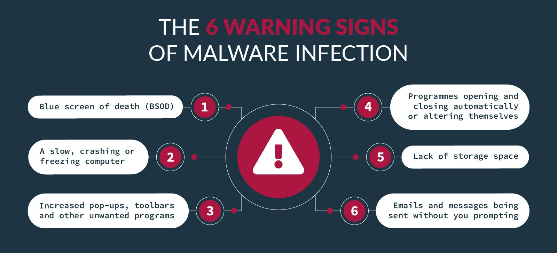

Slide 28
Malware Detection
If you’ve noticed any of the following, you may have malware on your device:
  A slow, crashing or freezing computer
  Blue screen of death (BSOD)
  Programs opening and closing automatically or altering themselves
  Lack of storage space
  Increased pop-ups, toolbars and other unwanted programs
  Emails and messages being sent without you prompting them

Slide 29
Malware Classification
Malware Classification is the process of assigning a malware sample to a specific malware family.
Malware within a family shares similar properties that can be used to create signatures for detection and classification.
Signatures can be categorized as static or dynamic based on how they are extracted.
A static signature can be based on a byte-code sequence, binary assembly instruction, or an imported Dynamic Link Library (DLL).

Slide 30
Malware Classification
Dynamic signatures can be based on file system activities, terminal commands, network communications, or function and system call sequences.
Effectively capture knowledge of the malware to represent.
The representation can enable classifiers to efficiently and effectively correlate data across large number of objects.
Malicious software is classified into families, each family originating from a single source base and exhibiting a set of consistent behaviors.

Slide 31
Social engineering
Social engineering is the term used for a broad range of malicious activities accomplished through human interactions.
It uses psychological manipulation to trick users into making security mistakes or giving away sensitive information.
Social engineering attacks happen in one or more steps.
  A perpetrator first investigates the intended victim to gather necessary background information, such as potential points of entry and weak security protocols, needed to proceed with the attack.
  Then, the attacker moves to gain the victim’s trust and provide stimuli for subsequent actions that break security practices, such as revealing sensitive information or granting access to critical resources.

Slide 32
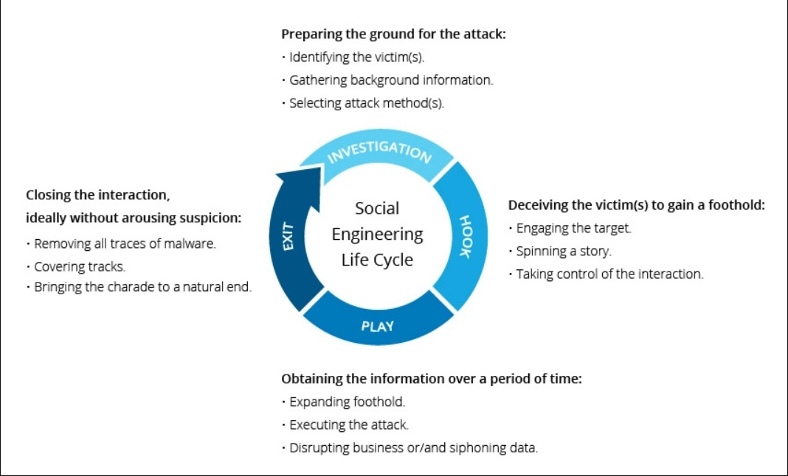

Slide 33
Social engineering
At its core it is manipulating a person into knowingly or unknowingly giving up information; essentially 'hacking' into a person to steal valuable information.
  Psychological manipulation
  Trickery or Deception for the purpose of information gathering
It is a way for criminals to gain access to information systems. The purpose of social engineering is usually to secretly install spyware, other malicious software or to trick persons into handing over passwords and/or other sensitive financial or personal information.

Slide 34
Social engineering
Social engineering is one of the most effective routes to stealing confidential data from organizations, according to Siemens Enterprise Communications, based in Germany. In a recent Siemens test, 85 percent of office workers were duped by engineering.
  “Most employees are utterly unaware that they are being manipulated,” says Colin Greenlees, security and counter-fraud consultant at Siemens.

Slide 35
Social Engineering Attacks
Not all attacks rely on technology vulnerabilities; in fact, some cyberattacks use little if any technology to achieve their goals.
Social engineering is a means of eliciting information (gathering data) by relying on the weaknesses of individuals.
Information elicitation may be the goal of the attack, or the information may then be used for other attacks.
Social engineering is also used as influence campaigns to sway attention and sympathy in a particular direction.
These campaigns can be found exclusively on social media (social media influence campaign) or may be combined with other sources (hybrid warfare influence campaign).
Notes:
Sway (control or influence)

Slide 36
Psychological Principles
Many social engineering attacks rely on psychology to affect others mentally and emotionally rather than physically.
At its core, social engineering relies on an attacker’s clever manipulation of human nature to persuade the victim to provide information or take actions.
Several basic principles make psychological social engineering highly effective.
Social engineering attacks usually rely on psychological principles. They also can involve physical procedures.

Slide 37
Psychological Principles
These are listed in Table with the example of an attacker pretending to be the chief executive officer (CEO) calling the organization’s help desk to reset a password.
Principle | Description | Example
Authority | To impersonate an authority figure or falsely cite their authority | “I’m the CEO calling.”
Intimidation | To frighten and coerce by threat | “If you don’t reset my password, I will call your supervisor.”
Consensus | To influence by what others do | “I called last week, and your colleague

Slide 38
Psychological Principles
Another technique is called prepending, which is influencing the subject before the event occurs. A common general example is a preview of a soon-to-be-released movie that begins with the statement, “The best film you will see this year!” By starting with the desired outcome (“The best film”), the statement influences the listener to think that way.
Threat actors use prepending with social engineering attacks, such as including the desired outcome in a statement that uses the urgency principle, as in “You need to reset my password immediately because my meeting with the board starts in five minutes.”

Slide 39
Psychological Principles
Because many of the psychological approaches involve person-to-person contact, attackers use a variety of techniques to gain trust. For example:
Provide a reason. Many social engineering threat actors are careful to add a reason along with their request. Giving a rationalization and using the word “because” makes it more likely the victim will provide the information.
  For example, I was asked to call you because the director’s office manager is out sick today.
Project confidence. A threat agent is unlikely to generate suspicion if she enters a restricted area by calmly walking through the building as if she knows exactly where she going (without looking at signs, down hallways, or reading door labels) and even greeting people she sees with a friendly Hi, how are you doing?

Slide 40
Psychological Principles
Use evasion and diversion. When challenged, threat agents might evade a question by giving a vague or irrelevant answer. They could also feign innocence or confusion, or keep denying allegations, until the victim eventually believes his suspicions are wrong. Sometimes a threat agent can resort to anger and cause the victim to drop the challenge. Who are you to ask that? Connect me with your supervisor immediately!
Make them laugh. Humor is an excellent tool to put people at ease and to develop a sense of trust. I can’t believe I left my badge in my office again! You know, some mistakes are too much fun to make only once!
Social engineering psychological approaches often involve impersonation, phishing, redirection, spam, hoaxes, and watering hole attacks.

Slide 41
Impersonation
Impersonation Social engineering impersonation (also called identity fraud) is masquerading as a real or fictitious character and then playing the role of that person with a victim.
  For example, an attacker could impersonate a help desk support technician who calls the victim, pretends that there is a problem with the network, and asks for her username and password to reset the account. Sometimes the goal of the impersonation is to obtain private information (pretexting).
To impersonate real people, the threat actor must know as much about them as possible to appear genuine. This type of reconnaissance is called credential harvesting and is typically carried out by Internet and social media searches.
Notes:
Impersonate (pretend to be (another person) for entertainment or fraud)

Slide 42
Phishing
One of the most common forms of social engineering is phishing.
Phishing is sending an email message or displaying a web announcement that falsely claims to be a legitimate enterprise in an attempt to trick the user into surrendering private information or taking action. Users are asked to respond to an email message or are directed to a website where they are requested to update personal information, such as passwords, credit card numbers, Social Security numbers, bank account numbers, or other information.
However, the email or website is actually an imposter site set up to steal the information that the user enters. Users may also receive a fictitious overdue invoice that demands immediate payment and, in haste, make the payment (called an invoice scam).

Slide 43
Phishing
Whereas at one time phishing messages were easy to spot due to misspelled
words and obvious counterfeit images, that is no longer the case. In fact, one reason that phishing is so successful today is that the emails and the fake websites are difficult to distinguish from legitimate ones: logos, color schemes, and wording seem to be almost identical.
Given Figure illustrates an actual phishing email message that looks like it came from a legitimate source.

Slide 44
Phishing
Phishing email message

Slide 45
Phishing Attacks
The following are several variations on phishing attacks:
Spear phishing. Whereas phishing involves sending millions of generic email messages to users, spear phishing targets specific users. The emails used in spear phishing are customized to the recipients, including their names and personal information, to make the message appear legitimate.
Whaling. One type of spear phishing is whaling. Instead of going after the “smaller fish,” whaling targets the “big fish”—namely, wealthy individuals or senior executives within a business who typically have large sums of money in a bank account that an attacker could access if the attack is successful. By focusing on this smaller group, the attacker can invest more time in the attack and finely tune the message to achieve the highest likelihood of success.

Slide 46
Phishing Attacks
Vishing. Instead of using email to contact the potential victim, attackers can use phone calls. Known as vishing (voice phishing), an attacker calls a victim who, upon answering, hears a recorded message that pretends to be from the user’s bank stating that her credit card has experienced fraudulent activity or that her bank account has had unusual activity.
The victim is instructed to call a specific phone number immediately (which has been set up by the attacker). When the victim calls, it is answered by automated instructions telling her to enter her credit card number, bank account number, Social Security number, or other information on the phone’s keypad.

Slide 47
Phishing Attacks
Smishing. A variation on vishing uses short message service (SMS) text messages and callback recorded phone messages. This is known as smishing.
The threat actors first send a text message to a user’s cell phone that pretends to come from their bank saying that their account has been broken into or their credit card number has been stolen. Along with the text message is a callback telephone number the customer is instructed to call immediately. That phone number plays a recording telling the customer to enter their Social Security number or credit card number for verification. The attackers then simply capture the information the user enters.

Slide 48
Phishing Attacks
Phishing continues to be a primary weapon used by threat actors. Phishing is considered to be one of the largest and most consequential cyber threats facing both businesses and consumers.
During the third quarter of 2019, phishing attacks increased by 46 percent from the previous quarter and almost doubled the number recorded during the fourth quarter of the previous year. One nation saw a 232 percent increase in phishing during 2019.13 It is estimated that these trends will continue

Slide 49
Redirection
If threat actors cannot trick a user to visit a malicious website through phishing, they can use other tactics to redirect the user.
What happens if a user makes a typing error when entering a uniform resource locator (URL) address in a web browser, such as typing goggle.com (a misspelling) or google.net (incorrect domain) instead of the correct google.com?
In the past, an error message like HTTP Error 404 Not Found would appear. However, today the user is often directed to a fake lookalike site filled with ads for which the attacker receives money for traffic generated to the site.
These fake sites exist because attackers purchase the domain names of sites that are spelled similarly to actual sites. This is called typo squatting. A well-known site such as google.com may have to deal with more than 1,000 typo squatting domains.

Slide 50
Pharming
Another redirection technique is pharming. Pharming attempts to exploit how a URL such as www.cengage.com is converted into its corresponding IP address 69.32.308.75.
A threat actor may install malware on a user’s computer that redirects traffic away from its intended target to a fake website instead. Another technique is to infect a DNS that would direct multiple users to inadvertently visit the fake site.

Slide 51
Spam
Spam is unsolicited email that is sent to a large number of recipients. Users receive so many spam messages because sending spam is lucrative.
It costs spammers very little to send millions of spam email messages. Almost all spam is sent from botnets, and a spammer who does not own his own botnet can lease time from other attackers ($40 per hour) to use a botnet of up to 100,000 infected computers to launch a spam attack. Even if spammers receive only a small percentage of responses, they still make a large profit.
  For example, if a spammer sent spam to 6 million users for a product with a sale price of $50 that cost only $5 to make, and if only 0.001 percent of the recipients responded and bought the product (a typical response rate), the spammer would still make more than $270,000 in profit.
Notes:
Unsolicited (unwanted)
Lucrative (profitable)

Slide 52
Hoaxes
Threat agents can use hoaxes as a first step in an attack. A hoax is a false warning, often contained in an email message claiming to come from the IT department.
The hoax purports that there is a “deadly virus” circulating through the Internet and that the recipient should erase specific files or change security configurations and then forward the message to other users. However, changing configurations allows an attacker to compromise the system. And erasing files may make the computer unstable, prompting the victim to call the phone number in the hoax email message for help, which is actually the phone number of the attacker.

Slide 53
Watering Hole Attack
In the natural world, similar types of animals are known to congregate around a pool of water for refreshment.
In a similar manner, a watering hole attack is directed toward a smaller group of specific individuals, such as the major executives working for a manufacturing company. These executives all tend to visit a common website, such as that of a parts supplier to the manufacturer.
An attacker who wants to target this group of executives tries to determine the common website that they frequent use and then infects it with malware that will make its way onto the group’s computers.

Slide 54
Physical Procedures
While some social engineering attacks rely on psychological manipulation, other attacks rely on physical acts.
These attacks take advantage of user actions that can result in compromised security.
Three of the most common physical procedures are
  Dumpster diving
  Tailgating
  Shoulder surfing.

Slide 55
Dumpster Diving
Dumpster diving involves digging through trash receptacles to find information that can be useful in an attack.
Given Table lists the different items that can be retrieved many of which appear to be useless and how they can be used.
.
Item retrieved | Why useful
Calendars | A calendar can reveal which employees are out of town at a particular time.
Inexpensive computer hardware, such as USB flash drives or portable hard drives | These devices are often improperly disposed of and might contain valuable information
Memos | Seemingly unimportant memos can often provide small bits of useful information for an attacker who is building an impersonation.

Slide 56
Dumpster Diving
An electronic variation of physical dumpster diving is to use the Google search engine to look for documents and data posted online that can be used in an attack.
This is called Google dorking, and it uses advanced Google search techniques to look for information that unsuspecting victims have carelessly posted on the web.
  For example, to find on the web any Microsoft Excel spreadsheets (.xlsx) that contain the column heading "SSN" (Social Security number), the Google search term intext:"SSN" filetype:xlsx can be used, or to find any Microsoft Word documents (.docx) that contained the word "passwords" as part of the title, the Google search term allintitle: "passwords" filetype:docx is used.

Slide 57
Tailgating
Organizations can invest tens of thousands of dollars to install specialized doors that permit access only to authorized users who possess a special card or who can enter a specific code.
These automated access control systems are designed to restrict entry into an area.
However, a weakness of these systems is that they cannot always control how many people enter the building when access is allowed; once an authorized person opens the door, one or more individuals can follow behind and also enter.
This is known as tailgating.

Slide 58
Tailgating
The following are several ways tailgating can occur:
A tailgater waits at the end of the sidewalk until an authorized user opens the door. She then calls out to him to “Please hold the door!” as she hurries to enter. In most cases, good etiquette wins out over good security practices, and the door is held open for the tailgater.
A tailgater waits near the outside of the door and then quickly enters once the authorized employee leaves the area.
A tailgater stands outside the door and waits until an employee exits the building. He then slips behind the person as he is walking away and grabs the door just before it closes to gain access to the building.
An employee conspires with an unauthorized person to allow him to walk in with him through the open door (called piggybacking).

Slide 59
Shoulder Surfing
If an attacker cannot enter a building as a tailgater without raising suspicion, an alternative is to watch an individual entering the security code on a keypad. Known as shoulder surfing
This technique can be used in any setting that allows an attacker to casually observe someone entering secret information, such as the security codes on a door keypad.
Attackers are also using webcams and smartphone cameras to "shoulder surf" users of ATM machines to record keypad entries

Slide 60
Impacts of Attacks
A successful attack always results in several negative impacts. These impacts can be classified as data impacts and effects on the organization.
Data Impacts
Whereas the goal of some attacks may be harm to a system, such as manipulating an industrial control system to shut down a water filtration facility, most attacks focus on data as the primary target.
Effects on the Enterprise
A successful attack can also have grave consequences for an enterprise. First, the attack may make systems inaccessible (availability loss). This results in lost productivity, which can affect the normal tasks for generating income (financial loss).

Slide 61


